Slide 1



Autolib hypothesis
testing project
Week 7: 12/09/2022
Moringa School | Sep
www.moringaschool.com

Slide 2

Authors
Antonia Mulinge
Eric Cheruiyot
Felista Mueni
Joseph Leshakwet

Slide 3
Metric for Success
This project will be considered a success when we are able to perform the following tasks:
Specify the null and alternate hypothesis.
Conduct EDA to uncover underlying patterns within the dataset that can guide the sampling technique.
Perform hypothesis testing and interpret the results.
Provide project summary and conclusions.

Slide 4
Define Data Analytic Question
Is the mean of Blue Cars returned equal to the mean of Utilib Cars taken?
Our hypothesis;
Null Hypothesis:The mean of blue cars returned and Utilib Cars taken is the same.
Ho : μ1 = μ2
Alternate Hypothesis: The mean of blue cars returned and Utilib Cars taken is not the same.
Ha : μ1 ≠ μ2

Slide 5
Data Understanding
The dataset used in the analysis contains records of electric car usage in France from January 2018 to June 2018. This dataset was originally sourced from opendataparis.com.
Some of the information in the dataset includes postal code, day of the week and total cars returned or picked up for blue cars, Utilib cars and Utilib 1.4 cars.
In order to come up with a clean data set we performed data cleaning functions such as dealing with data sets, fixing messy columns, dealing with outliers, and anomalies.

Slide 6
Exploratory Data Analysis
The data has 11 integer and 2 object data types with no missing values and duplicates.
There are several 'outliers' in the data set but we include them in analysis since they are valid observations.

Slide 7
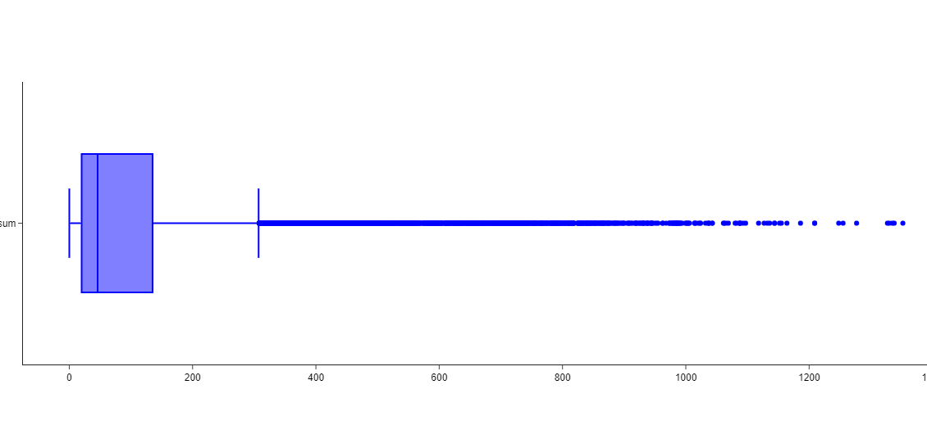
Data Understanding : Ex - Dealing with Outliers
From Below: There are several 'outliers' in the dataset for the number of blue cars taken and returned. However, there is no sufficient evidence that point to the likelihhod of these outliers being erroneous records. analysis.E

Slide 8
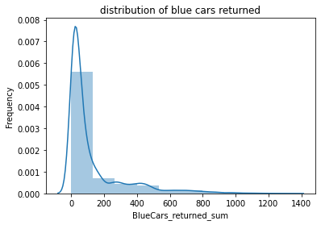
Univariate analysis
Blue Cars returned sum Histogram distribution plot shows the variable is right tailed.

Slide 9
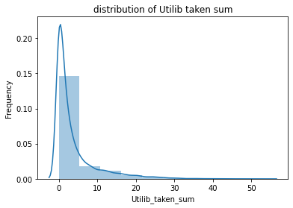
Utilib Cars taken sum Histogram distribution plot shows the variable is right tailed.

Slide 10
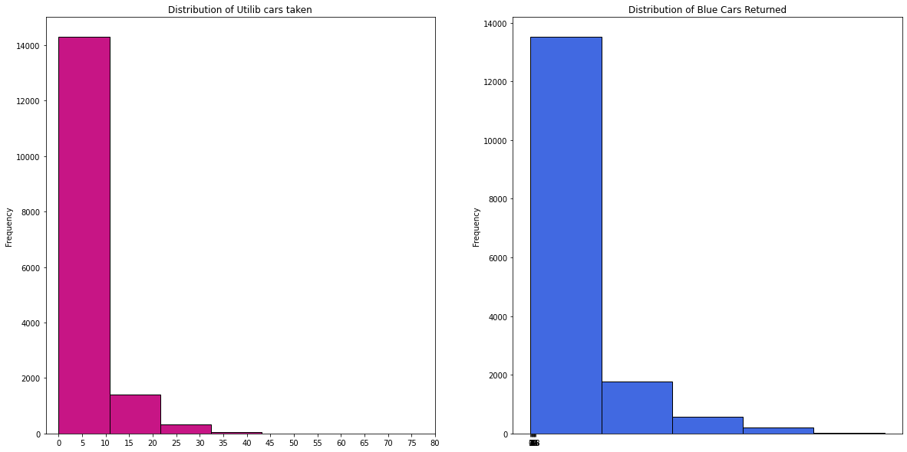
Histograms of blue car returned & Utilib cars taken
Below shows:
We notice that the two attributes above do not follow a normal distribution. Instead, they are skewed to the right.

Slide 11
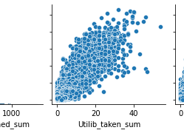
Bivariate analysis
We plotted correlation graphs of the numerical variables against blue cars returned to check relationships.
We can establish that Blue Cars returned sum has a strong correlation with BlueCar_taken sum,Taken,Slots_Freed_sum and Utilib_returned_sum to name but a few.

Slide 12
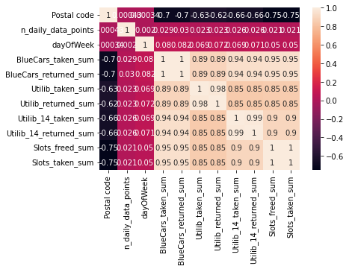
Bivariate analysis
We plot the hetmap of correlations
Blue cars returned and utilib cars taken correlation is positive.

Slide 13
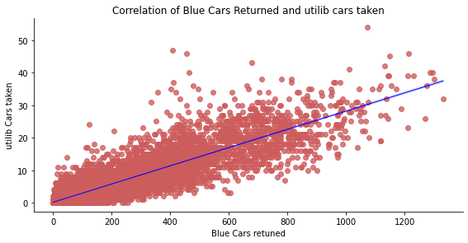
Bivariate analysis
We plot the # scatter plot of blue cars returned and utilib cars taken
Blue cars returned and utilib cars taken correlation is positive.

Slide 14
Hypothesis Testing
Our Hypothesis is as follows;
Null Hypothesis:The mean of blue cars returned and Utilib Cars taken is the same.
Ho : μ1 = μ2
Alternate Hypothesis: The mean of blue returned cars and Utilib Cars taken is not the same.
Ha : μ1 ≠ μ2

Slide 15
Step 1: Look on Distribution of the Data.
We will be using Shapiro-Wilk Test to determine normality of our data. This is a popular test when determining the distribution of data.
Output : Statistics=0.665, p=0.000
Sample does not look Gaussian (reject H0).
When plotting the histogram distribution we can see that the graph is right tailed meaning that the data is skewed towards the right hence not normal.

Slide 16
Same applies when plotting the histogram for the Utilib_taken_sum.Distribution is right tailed hence no normality.
From both the normality calculation and graphs we can clearly see that our data is not normally distributed.
The next phase of our analysis will be to calculate the difference in our groups given that both distributions are not normal.
We will be using the Mann Whitney U Test since this Test can be used regardless if the data is normally distributed as compared to the T-test approach.

Slide 17
Mann Whitney U test results at alpha = 0.05 :
OUTPUT = Statistic: 10149987.000
P-Value: 0.00000000000000000000
Reject H0 - Mean of Utilib cars taken and Blue Cars returned is not equal
Conlusion: From the both the Mann Whitney and Shapiro Calculation, both tests rejected the Null hypothesis that the mean of Utilib cars taken and Blue Cars returned is equal. Hence we accept the Alternative Hypothesis that the mean of Utilib cars taken and Blue Cars returned is not equal.

